Slide 1
软件体系结构
9 模型视图控制器风格
刘旭东
cameran@hit.edu.cn
Sunday, November 8, 2026

Slide 2
主要内容
新型软件体系结构风格
  MVC
  Distributed Computing: P2P & Cluster
  Service Oriented Architecture (SOA)
  Cloud computing
MVC架构风格
  Problems in web-based application development
  What is MVC?
  Struts MVC
  Panther MVC
  Implementation of Java EE MVC

Slide 3
Concerns in Web-based application development
Multi-language programming
Data transfer
Page flow
……

Slide 4
Multi-language programming
HTML
CSS
Javascript
Jsp/Asp/php…

Slide 5
Data transfer
The problem
  How the data in HTML are transferred to the backend?
  How the data in Backend are transferred to the HTML?
Solutions
  Request Object (Servlet API)
  Javabean
  Jason

Slide 6
Page Flow
In Java EE,
  HTTP Request→JSP
  HTTP Request→Servlet
  JSP→JSP
  Servlet→JSP
  ……
Solutions
  Hard code
  Front Controller

Slide 7
What is MVC?
In software engineering, Model–View–Controller (MVC) is an architectural pattern that splits interactions between users and applications into three roles: the Model (business logic), the View (user interface), and the Controller (user input). This separation of concerns facilitates the independent development, testing, and maintenance of each role(关注点分离:模型、视图和控制器).
MVC was first described in 1979 by Trygve Reenskaug, then working on Smalltalk at Xerox PARC.
Since the late 1990s, MVC is commonly classified as an architectural pattern, i.e. a classic way of structuring software that is used in a software architecture in the modern sense of Shaw and Garlan.
The goal of MVC is to simplify the architecture by decoupling models and views, and to make source code more flexible and maintainable(从开发者的角度看，实现model与view的解耦).
Very popular, used extensively in Java and other languages.

Slide 8
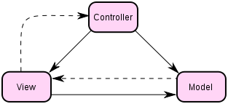
What is MVC?
Components: Model, View , Controller
Connectors: Explicit Invocation， Implicit Invocation or other mechanisms (e.g. HTTP protocol)
Notes:
http://en.wikipedia.org/wiki/Model%E2%80%93view%E2%80%93controller

Slide 9
Model(模型)
Model is responsible for
  Providing the data from the database and saving the data into the data store(负责数据存取).
  All the business logic are implemented in the Model(负责业务逻辑实现).
  Data entered by the user through View are checked in the model before saving into the database(负责数据验证).
In event-driven systems, the model notifies observers (usually views) when the information changes so that they can react.

Slide 10
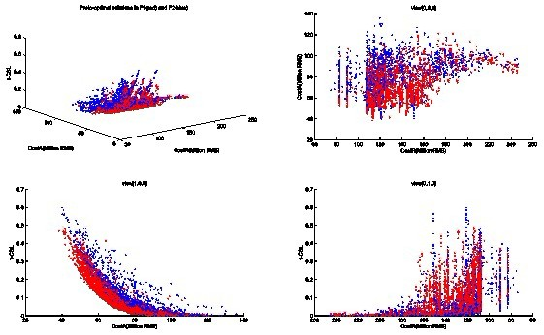
View(视图)
View is responsible for:
  Taking the input from the user, (获取用户输入)
  Dispatching the request to the controller, and then (向controller发送处理请求)
  Receiving response from the controller and displaying the result to the user.(接收来自Controller的反馈并将model的处理结果显示给用户)
Multiple views can exist for a single model for different purposes.(一个model可能有多个View)

Slide 11
Controller
Controller is responsible for:
  Receiving the request from client.(接收来自客户的请求)
  Executing the appropriate business logic from the Model, and then(调用model执行)
  Producing the output to the user using the View component. (调用View显示执行结果)

Slide 12
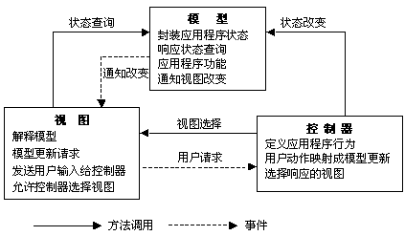
What is MVC?
Mechanism :

Slide 13
Advantages of MVC
Two principal separations:
  Separating the presentation from the model
  Separating the controller from the view
Advantages:
  Make source code more flexible and maintainable.(代码易开发易维护)
  Make it very easy to have multiple different displays of the same information(同一信息可以有不同的展现方式).
  Make it very easy to test all the domain logic. Because Non-visual objects are usually easier to test than visual ones(业务逻辑更易测试).

Slide 14
MVC Frameworks
J2EE:
  Struts
  Spring MVC
PHP
  CakePHP
  Strusts4php
C#.NET
  Girders
Ruby on Rails

Slide 15
Java EE实现MVC技术基础
Java Server Pages
  Java Server Pages (JSP) is a technology that helps software developers serve dynamically generated web pages based on HTML, XML, or other document types. Released in 1999 by Sun Microsystems.
  Architecturally, JSP may be viewed as a high-level abstraction of Java servlets. JSPs are translated into servlets at runtime; each JSP's servlet is cached and re-used until the original JSP is modified.
Servlets
  A Servlet is a java based server side web technology. A software developer may use a servlet to add dynamic content to a Web server. The generated content is commonly HTML, but may be other data such as XML. Released in June 1997 by Sun Microsystems.
  Technically speaking a Servlet is a Java class in Java EE that conforms to the Java Servlet API, a protocol by which a Java class may respond to requests. .
Java Beans
  Described in Lecture 1.

Slide 16
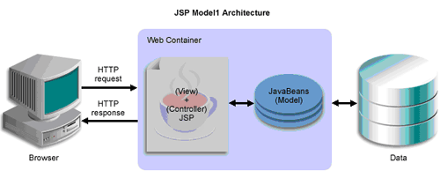
Java EE WEB Model 1:Non-MVC
Notes:
http://www.javaworld.com/javaworld/jw-12-1999/jw-12-ssj-jspmvc.html

Slide 17
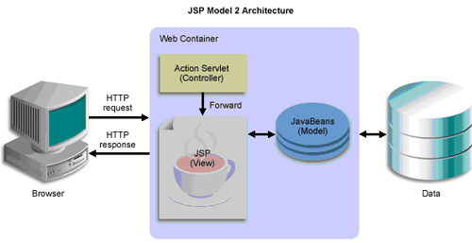
Java EE WEB Model 2:MVC

Slide 18

Struts MVC
Apache Struts is an open-source web application framework for developing Java EE web applications.
It uses and extends the Java Servlet API to encourage developers to adopt a model-view-controller (MVC) architecture.
It was originally created by Craig McClanahan and donated to the Apache Foundation in May, 2000.

Slide 19
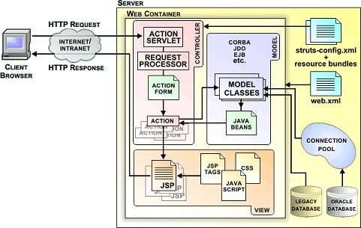
Struts MVC

Slide 20
Components of Struts
struts-config.xml Struts配置文件
ActionServlet 控制器（Struts 的核心模块）
Action Class 包含事务逻辑
ActionForm 显示模块数据
ActionMapping 帮助控制器将请求映射到操作
ActionForward 用来指示操作转移的对象
ActionError 用来存储和回收错误
JSP 用于构造界面
Struts Tags JSP标记库

Slide 21
ActionServlet
截获用户的Http请求(含Form数据),把这个请求映射到相应的Action类
创建一个ActionForm bean实例,将Form数据放入ActionForm中
调用Action实例的perform()方法
将ActioForm bean,Action Mapping对象,request和response对象传给Action的execute()方法
Action的execute方法返回一个ActionForword对象，根据方法执行情况转到相应的jsp页面

Slide 22
How to build a simple Struts application?
Update the web.xml file(optional)
Create the struts-config.xml file
Build the View Components (JSPs)
Build the Model Components (ActionForm Class)
Build the Controller Components (Action Class)

Slide 23
Update the web.xml file
Config the ActionServlet and the URL Pattern
<servlet>
<servlet-name>action</servlet-name>
<servlet-class>org.apache.struts.action.ActionServlet</servlet-class>
</servlet>
<servlet-mapping>
<servlet-name>action</servlet-name>
<url-pattern>*.do</url-pattern>
</servlet-mapping>

Slide 24
Create the struts-config.xml file
Within this file you’ll define the action-mappings and form-beans.(配置action-mappings 和 form-beans)
  The action-mappings tell the ActionServlet which action classes to include within the application.
  The form-beans define the ActionForm classes required within the application.
<action-mappings type="org.apache.struts.action.ActionMapping">
<action path="/simpleAction"
type="edu.depaul.struts.SimpleAction"
name="simpleBean"
scope="request"
input="/index.jsp">
<forward name="next" path="/next.jsp"/>
<forward name="again" path="/index.jsp"/>
</action>
</action-mappings>
<form-beans type="org.apache.struts.action.ActionFormBean">
<form-bean name="simpleBean" type="edu.depaul.struts.SimpleForm"/>
</form-beans>

Slide 25
Building a JSP
Must include a form in the jsp file (必须包含一个Form)
To create a JSP using Struts you may use the tag libraries provided by the Struts Framework (可以使用taglib构造界面).
  struts-bean taglib：包含在访问bean和bean属性时使用的tag，也包含一些消息显示的tag。
  struts-html taglib：包含用来生成动态HTML用户界面和窗体的tag。
  struts-logic taglib ：包含的tag用来管理根据条件生成输出文本，和其它一些用来控制的信息。
  struts-template taglib包含的tag用来定义模板机制。
<html:form action="simpleAction" method="POST">
First Name:
<html:text property="firstName"/>
<font color="red"><html:errors property="firstName"/>
</font>
Last Name:
<html:text property="lastName"/>
<font color="red"><html:errors property="lastName"/>
</font>
<html:submit value="Submit"/>
</html:form>

Slide 26
Building an ActionForm
The ActionForm is a JavaBean which contains the data entered trough an HTML form (是一个JavaBean,存储HTML Form中的数据).
The ActionForm should also contain the get & set methods for each property.
To create a ActionForm, you will need to extend the class org.apache.struts.action.ActionForm, this makes it dependent on the Struts API (依赖于struts框架)
The ActionForm may also implement a validate method to perform data entry validations before actually performing the requested action (可进行服务器端数据校验).
public class SimpleForm extends ActionForm
{
private String firstName;
private String lastName;
public String getFirstName()
{
return firstName;
}
... other getters and setters
}

Slide 27
Building an Action Class
public class SimpleForm extends Action{
…
public ActionForward execute(
ActionMapping actionMapping,
ActionForm actionForm,
HttpServletRequest httpServletRequest,
HttpServletResponse
httpServletResponse) throws Exception{
//getting posted information
SimpleForm simpleForm = (SimpleForm) actionForm;
///... - business – related processing (调用相关的业务逻辑处理)
httpServletRequest.setAttribute("simpleForm", simpleForm);
//passing control to the next page
return actionMapping.findForward("next");
}
}
Action is a bridge to connect the ActionServlet and the model(将 HttpServletRequest 转换为业务逻辑)
Extend the class org.apache.struts.action.Action (依赖于struts框架)
implement the execute method:
  ActionForward execute(ActionMapping , ActionForm , HttpServletRequest , HttpServletResponse );

Slide 28


Panther MVC
The Panther is a web application framework for developing web-based Enterprise Information System(EIS) applications.
It is a simple implementation of model-view-controller (MVC) architecture.
It was originally created by ICES in 2005.
Main concerns:
  Separation of presentation and business logic
  Decouple the structure cross-cutting
  Rapid development
  High Maintainability

Slide 29
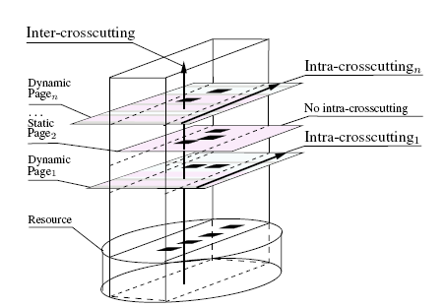
Why Panther?
Web application
  Hybrid programming (混合编程)
Structure Crosscutting(MVC没有很好解决Structure Crosscutting)
  The structure concern refers to the entity of the business objects(数据结构关注).
  The MVC gives a clean separation between the presentation, functional and control concerns. However, it does not modularize the structure crosscutting concerns perfectly

Slide 30
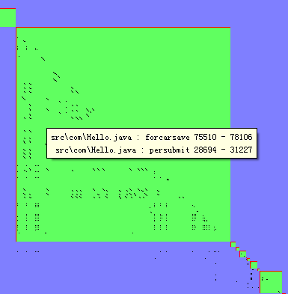
Why Panther?
Clone codes
  Similar user interface
  Similar business logic
Object 1
Object 2
Object n
Properties
Properties
Properties
Common Opers
Other Opers
Common Opers
Other Opers
Common Opers
Other Opers
……
Common Opers 公共操作，如数据库增删改(CRUD)，状态控制操作等

Slide 31
Traditional Solution: DTO
the data transfer object (DTO) is a pure data object only has some getter and setter operations.
DTO can separate the structure concern from the model component in MVC model by automating the object-relational (O-R) mapping.
The DTO model has been adopted in many popular MVC frameworks, such as Strut , Spring, etc.
But it dose not separate the structure concern from view component.
In the DTO model, every table has a class to implement the O-R mapping

Slide 32
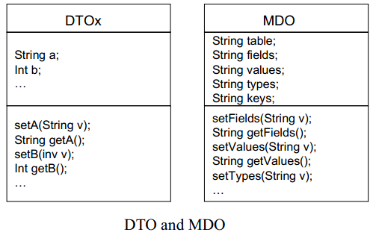
Panther Solution : MDO
the Meta Data Object (MDO) is also a pure data object only has some getter and setter operations.
But the data in MDO is meta data.
The MDO model is based on instances rather than classes, there is only one class to implement both the O-R mapping and the UI-R mapping, so the extra advantage of MDO model is the low volume of the source code.

Slide 33
Solutions: MDO for UI-R映射
Each Form
(Data Block)
In Web Pages
元数据
数据
影射
操作
界面修饰
用户界面UI由一个或多个数据块(Data Block)组合而成
每个数据块由三部分元数据组成：数据、操作和界面装饰

Slide 34
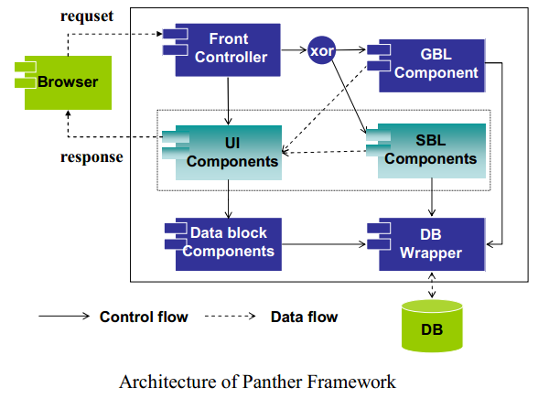
Architecture of Panther

Slide 35
Components of Panther
There are 8 components:
  Nat-config.xml
  front controller (FC)
  Meta data object (MDO)
  generic business logic component (GBLC)
  specific business logic component (SBLC)
  user Interface component (UIC)
  data block component (DBC) , implemented by taglib
  database wrapper (DBW)
对比struts,少了ActionForm

Slide 36
FC
解析nat-config.xml,得到URL Mapping信息
截获用户的Http请求，并进行用户权限控制
若有权限，根据http请求创建MDO实例,将DBC中的元数据及数据放入MDO中，并将MDO、Request、Response等对象被封装到Action对象中
根据URL Mapping创建相应的BLC(SBLC或GBLC)实例
调用BLC实例的requestProcess()方法
将Action对象传给BLC的requestProcess()方法，
根据MDO中的跳转信息转到相应的jsp页面

Slide 37
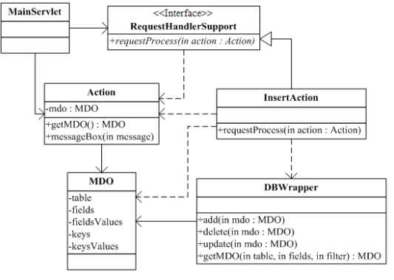
The core Class Diagram
FC
SBLC
DBW
MDO

Slide 38
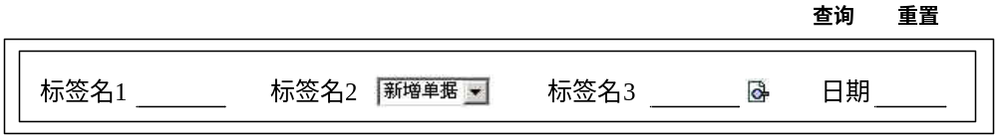
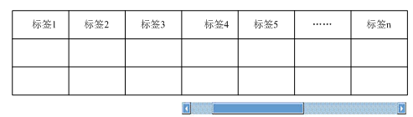
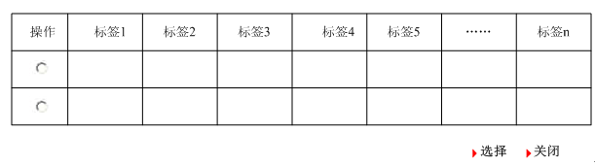
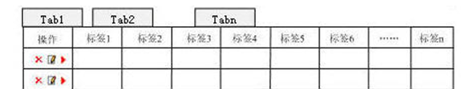
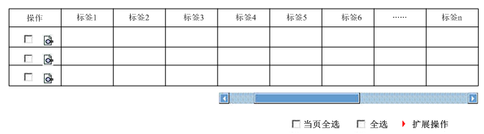
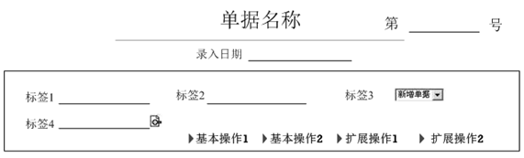

DBC

Slide 39
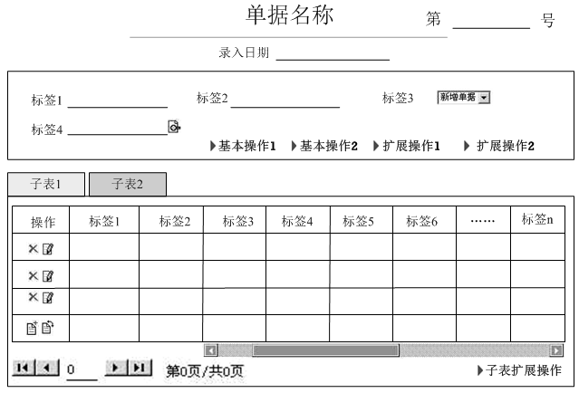
Combination of DBC

Slide 40
How to build a simple Panther application?
Update the web.xml file (optional)
Update the nat-config.xml file
Build the UIC (JSPs)
Build the SBLC Components (optional)
How to build a Struts application
Update the web.xml file (optional)
Update the struts-config.xml file
Build the View Components (JSPs)
Build the Model Components (ActionForm Class)
Build the Controller Components (Action Class)

Slide 41
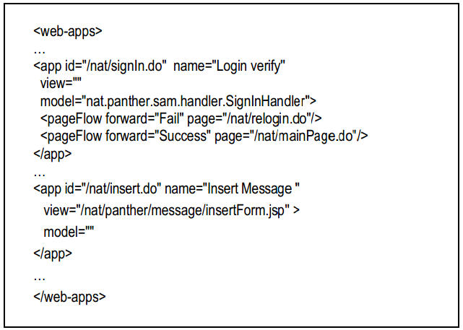
Update the nat-config.xml file

Slide 42
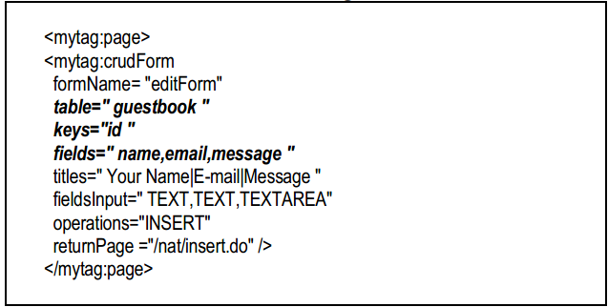
Build the UIC (JSPs)

Slide 43
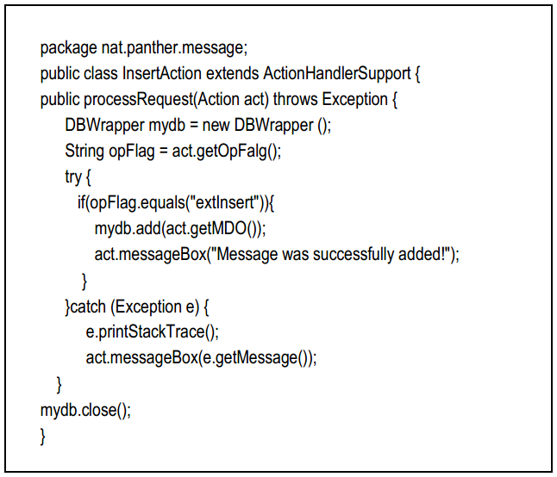
Build the SBLC Components (optional)
“nat.panther.message.InserAction”

Slide 44
Advantages of Panther
High adaptability
  For example, changing the existing structure of the guestbook to add a date field, we only need to modify the insertForm.jsp. So the framework can significantly reduce the application maintenance cost.
High reusability
  The lines of codes (LOC) of JSPs in Panther is 1/10 to 1/20 of original JSPs.

Slide 45
Limitations of Panther
The Tag library are only fit for assembly the patterned user interfaces in the web-based EIS, because Panther is a domain-specific framework
The domain objects are dependent with the Panther Framework because of MDO

Slide 46
实验3指导
Implementation of Java EE MVC

Slide 47
Implementation of Java EE MVC
为了简化实现，以下内容不考虑
  自动生成Struts中的ActionForm Bean或Panther中的MTO
  权限控制
  自定义TagLib
*.do
Front
Controller
Browser
XML
Model
View
Control flow
(include data)
Data flow

Slide 48
Core Technology
URL Mapping(URL映射)
MainServlet(主控制器)
Inversion of Control(反向控制)
Page Flow(页面流转)

Slide 49
URL Mapping (URL映射)
Why？
  而非直接请求，通过Controller协调View和Model
  可扩展
  安全
Solution: XML File
  定义URL请求与View及Model之间的映射关系
  定义页面流转关系Page Flow

Slide 50
MainServlet(主控制器)
继承HttpServlet
  HttpServlet 类包含 init(), doGet(), doPost(), destroy(), service() 等方法
覆盖init()方法，在该方法中解析XML文件，读取URL Mapping信息
覆盖doGet()方法，在该方法中实现Controller的功能
覆盖doPost()方法，在该方法中调用doGet()

Slide 51
Inversion of Control(反向控制)
Controller调用哪个Model?如何实例化并调用Model？
  IoC将控制权由代码中转到了外部,即XML文件定义的URL Mapping
  通过ClassLoader装载Model对应的Java类
  Model实现指定的interface方法
  Controller调用Model的interface方法
更高级的IoC？
  Model不需要继承指定的interface方法
  在外部文件中定义IoC容器要调用的类和方法，通过反射机制实现调用，进而实现Model与framework的解耦
RequestHandler handler = (RequestHandler) getClass().getClassLoader()
.loadClass(requestProcessorString).newInstance();

Slide 52
Page Flow(页面流转)
Model处理完成后，页面不切换，例如查询界面（查询和查询结果在一个界面）
Model处理完成后，页面将切换，可依据Model处理结果，判定页面流动，例如微博登陆成功后跳转到微博主界面
request.getRequestDispatcher(view).forward(request, response);
//进行页面流处理
String outFlag = (String) request.getAttribute("outFlag");
String screen = (String) app.getPageFlows().get(outFlag);
if (screen == null) {
screen = view;
}
request.getRequestDispatcher(screen).forward(request, response);

Slide 53
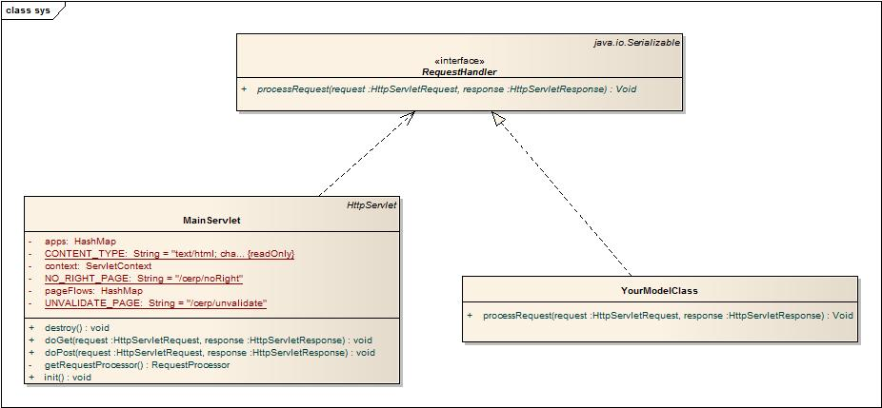
The Core Class Diagram

Slide 54
Good Luck!

